Slide 1

FREEFIX
A Movie Recommendator
Iván Peña

Slide 2

Getting The Data

Slide 3
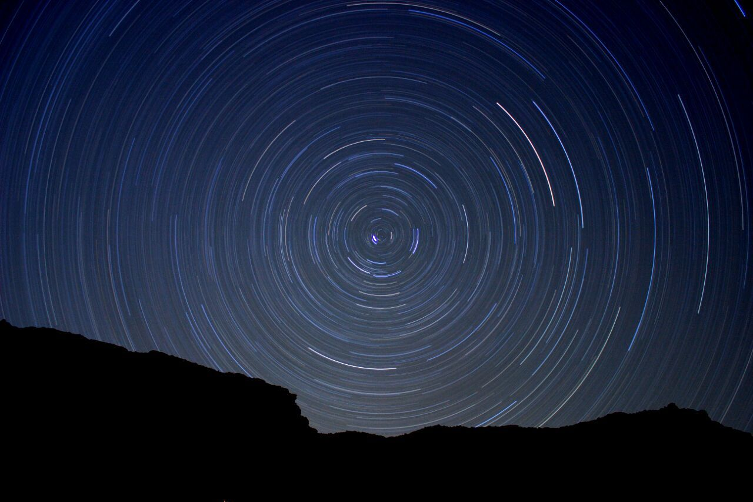
ITEM
BASED

Slide 4

DATA WRAGLING

Slide 5

LIBRARIES
RE
SCIPY
SPATIAL
WORDCLOUD
FUZZYWUZZY
FUZZ

Slide 6
FEAUTURES
USER GIVEN TAX
KEYWORDS
2
TITLE SIMILARITY
KEYWORDS
1
ONE HOT ENCODING
0.8
GENRES SIMILARITY
GROUP OF USER BY MOVIE ID
0.2
ADVERAGE USER RATINGS
MOVIE YEAR
SEPARATING BY MOVIE YEAR DISTANCE
0.1
CREATING GROUOS 1 TO 6
0.005
# OF USERS RATINGS

Slide 7
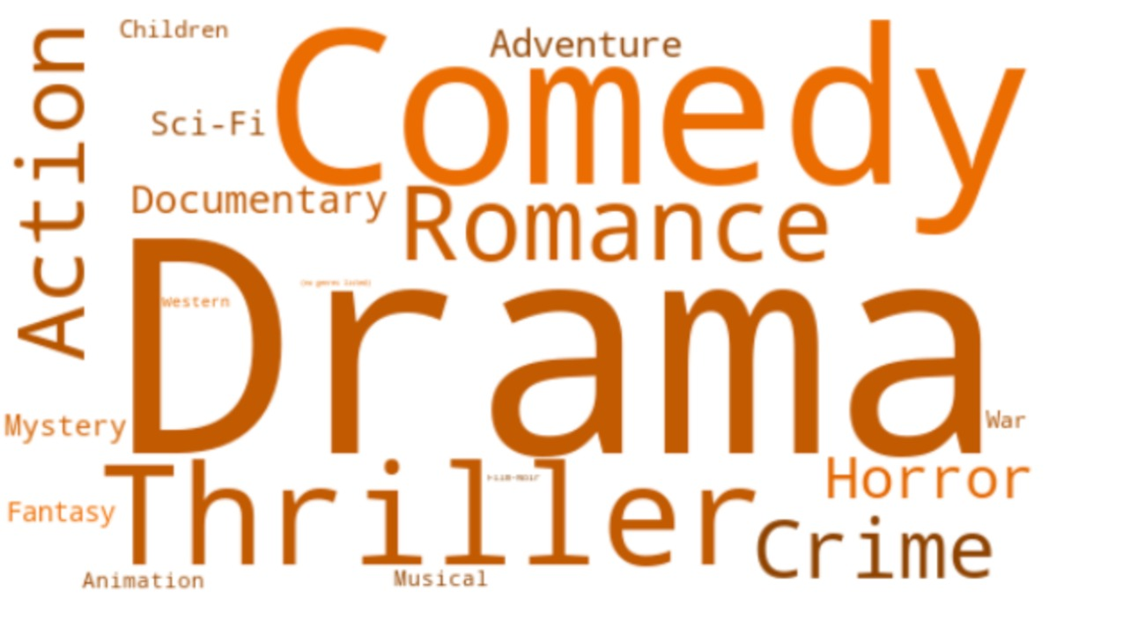

Slide 8

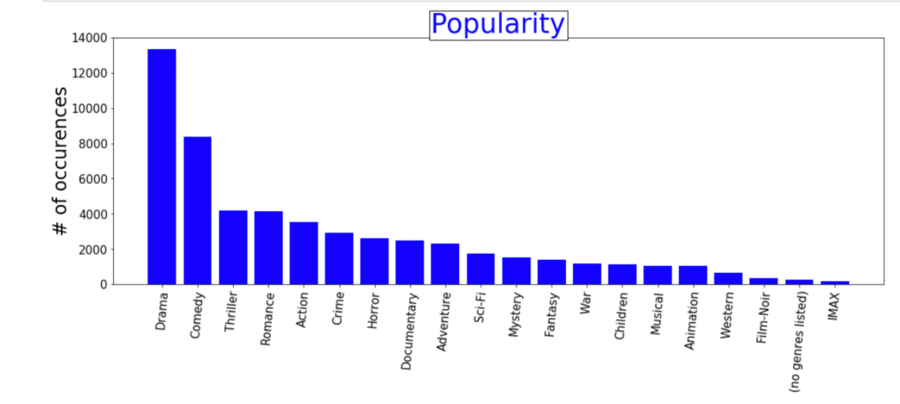

Slide 9

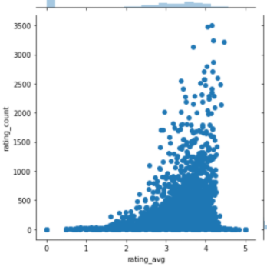
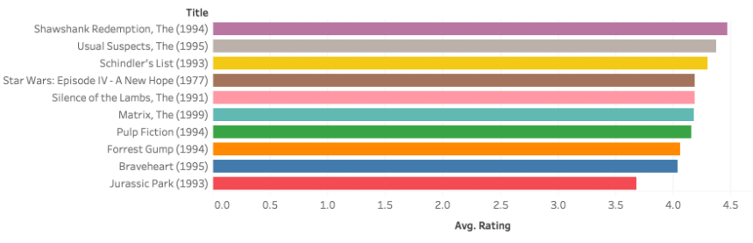
Rankings

Slide 10

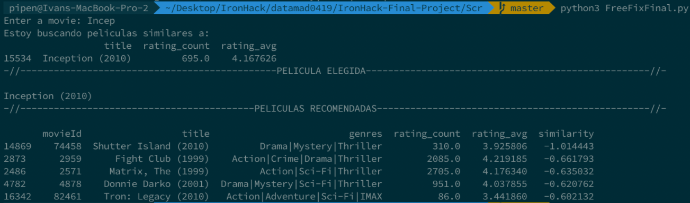
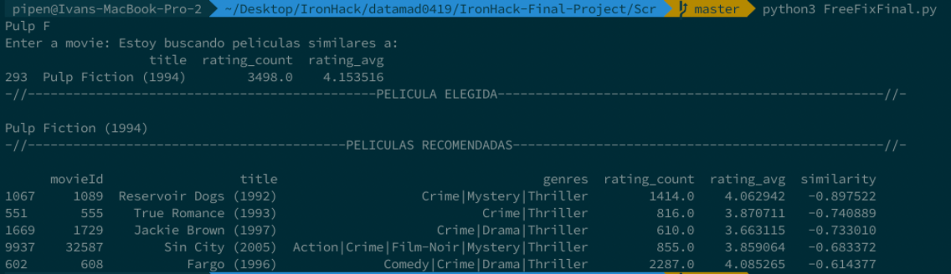

Slide 11
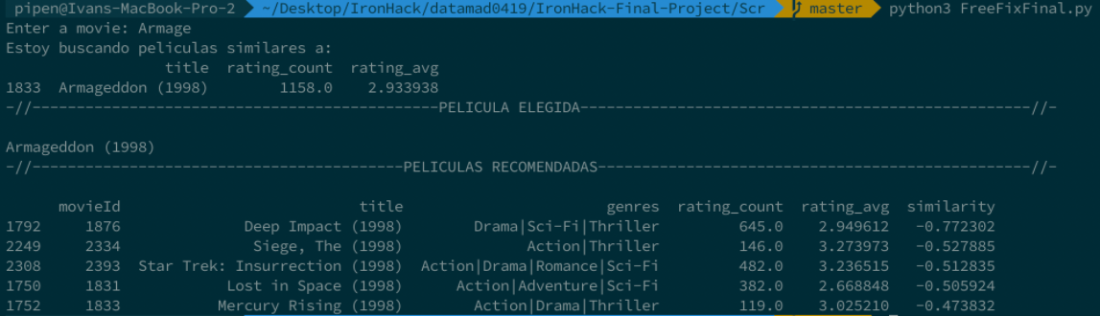
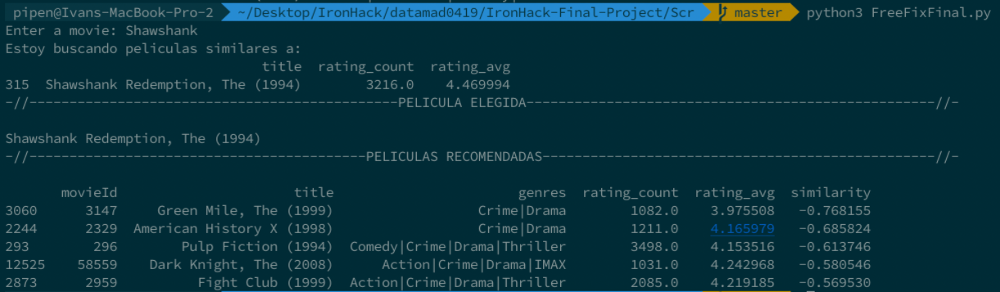

Slide 12






FINALS THOUGHT

